Slide 1
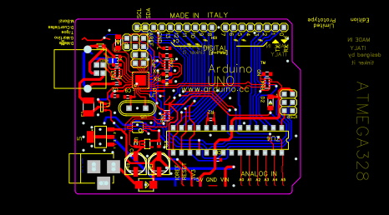

IEEE Virtual Workshop 3
Circuit & PCB Design using EAGLE
Thursday, October 1, 2020

Slide 2
What is a PCB?
From Wikipedia:
A printed circuit board (PCB) mechanically supports and electrically connects electronic components or electrical components using conductive tracks, pads and other features etched from one or more sheet layers of copper laminated onto and/or between sheet layers of a non-conductive substrate. Components are generally soldered onto the PCB to both electrically connect and mechanically fasten them to it. Printed circuit boards are used in all but the simplest electronic products. They are also used in some electrical products, such as passive switch boxes.

Slide 3
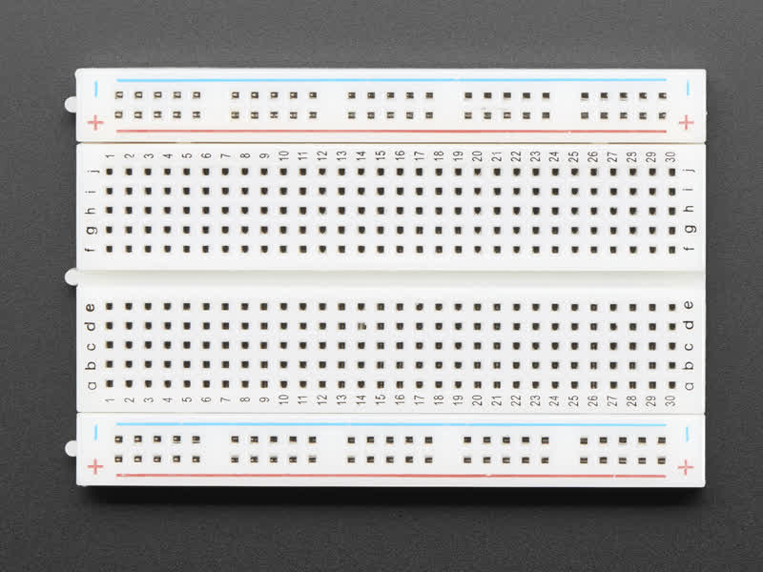
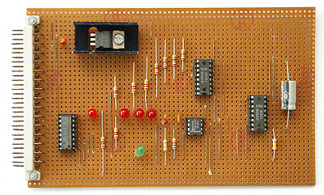
Why PCB’s (not the alternatives) ?
Alternative #1: Breadboard
More Expensive
Not many different sizes (usually large)
Parasitics (what??)
One-Sided
Alternative #2: Perf Board
Requires a lot of planning
Only one sided
Hard to troubleshoot / repair

Slide 4
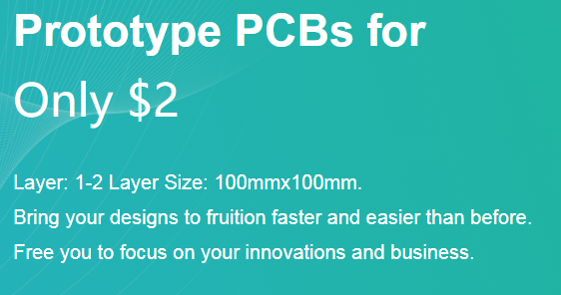
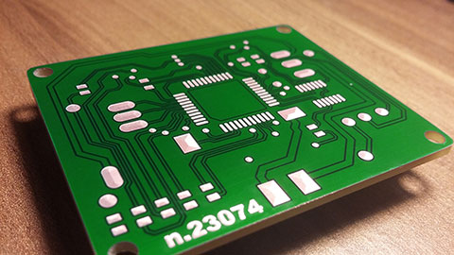
Benefits of PCBs
Cost: $2 for 5 PCBs pf 100mm X 100mm (about 4 inches square)
Boards are 2 sided (can be up to 24 layers for more complicated boards!)
Easy to scale up
More compact than other methods
Easy to adjust / troubleshoot
Built in double-checks for wiring
Allows for surface mount components

Slide 5
How are we doing this???
Create a schematic (What we’re going to place on the board)
Convert this over to a board layout
Move parts as necessary
Wire components using ‘traces’

Slide 6
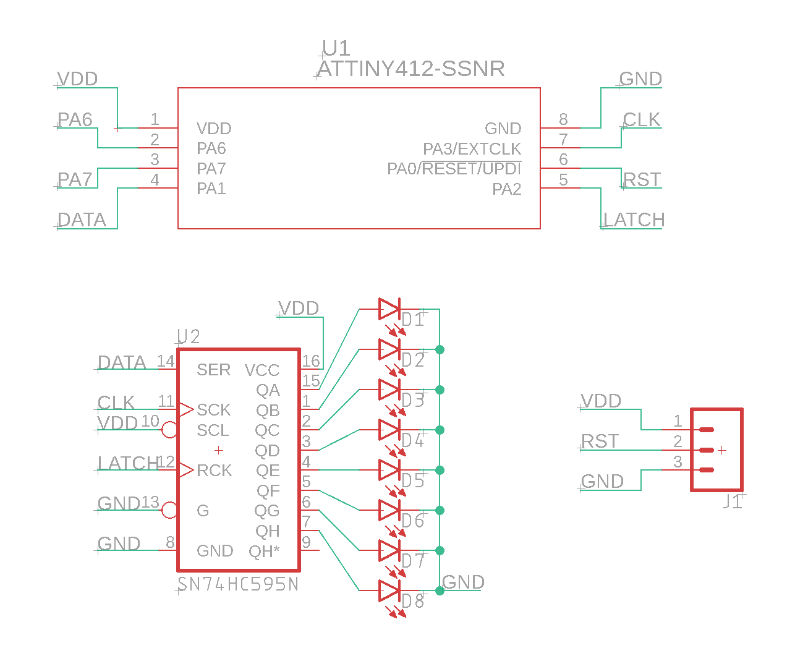

Slide 7
Some Rules:
No 90 degree angles (or any other sharp angles)
Cannot intersect 2 wires on the same side of the board
Try to keep wires spaced apart (not too close to each other)

Slide 8
Time to get competitive!
The best overall PCB design will be ordered and passed out!
Deadline to submit files is October 8th at midnight

